Slide 1
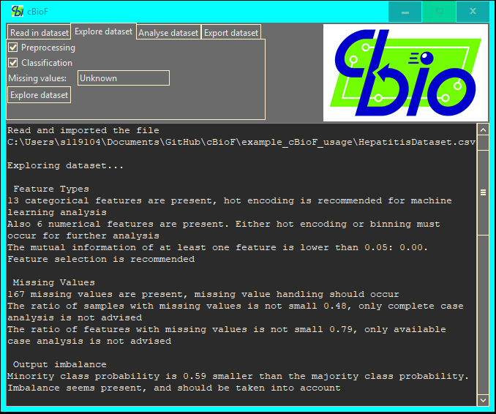
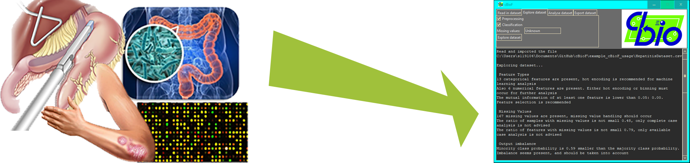
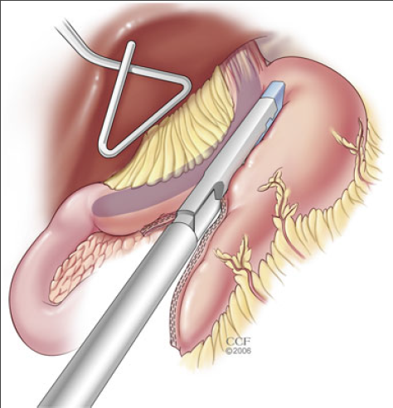

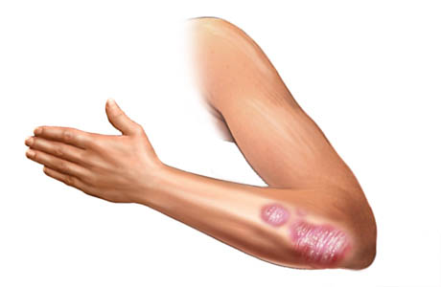
A Computational Biology Framework
A data analysis tool to support biomedical engineers in their research
Tim Beishuizen, Graduation presentation
University of Technology Eindhoven, department Biomedical Engineering and department Computer Science and Engineering

Slide 2
Contents
Research question
Case studies
Sub questions
Project specifications
Research lines
Feature selection
Missing value handling
Dataset exploration
Framework
Notes:
1:33

Slide 3
What aspects are of importance to be included in a framework for Biomedical Engineers for more efficient data analysis?

Slide 4
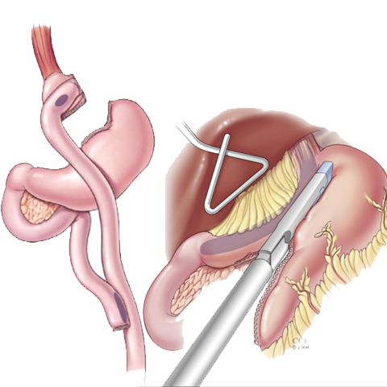
Case study 1: Bariatric surgeries
Clinical and survey dataset
Missing values
Combining two datasets

Slide 5
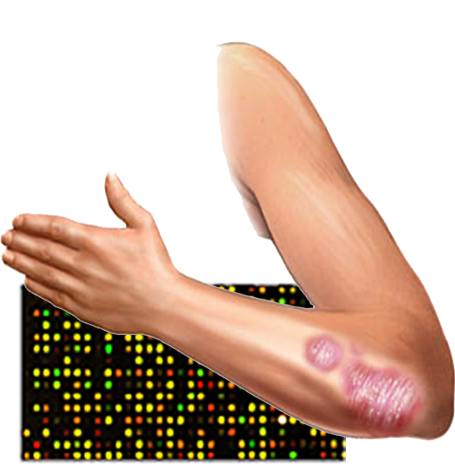
Case study 2: Skin diseases
Microarray dataset -> Gene expressions
50.000+ genes

Slide 6
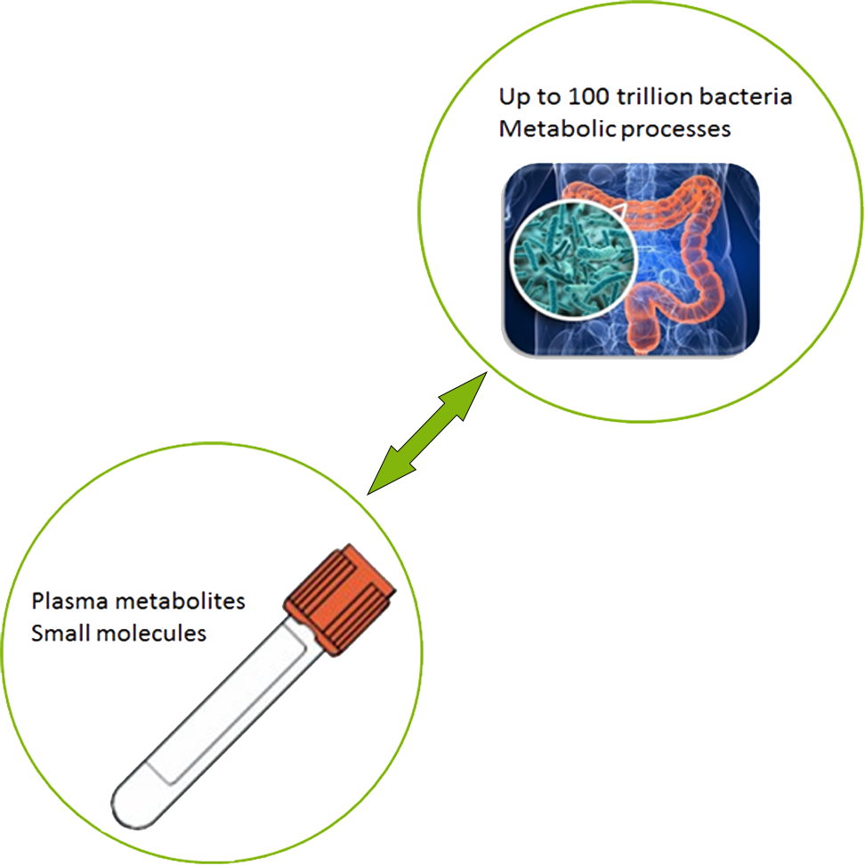
Case study 3: Metabolic syndrome
Clinical datasets
Initial exploration
Combining two datasets

Slide 7
Sub-questions
What feature selection methods show the best performance and as such should be added to the framework?
What missing value handling methods show the best performance and as such should be added to the framework?
Which initial analyses help find suitable preprocessing and data analysis algorithms?
Notes:
4:30

Slide 8
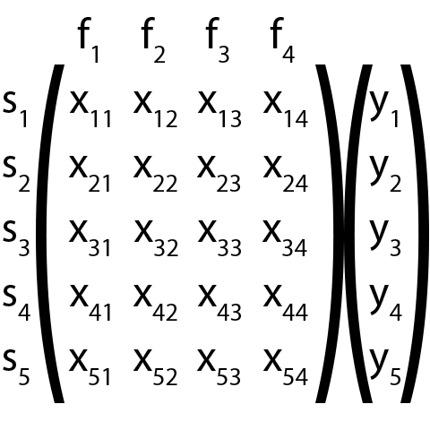
Project description
Data matrix
Samples (s)
Features (f)
Output (y)
Classification
Python
Statistics
Machine learning

Slide 9
Clinical datasets
Data out of a clinic
Missing values
Combining data issues
Survey datasets
Questionnaire data
Missing values
Bias due to subjectivity
Datasets
Microarray datasets
Gene expression
Many features
Big datasets
Mass spectrometry datasets
Protein mass
Many features
Differences between features
Notes:
+- 8 min

Slide 10
Feature selection
Datasets
Microarray
Mass spectrometry
Feature selection methods
Filter methods
Wrapper methods
Embedded methods

Slide 11
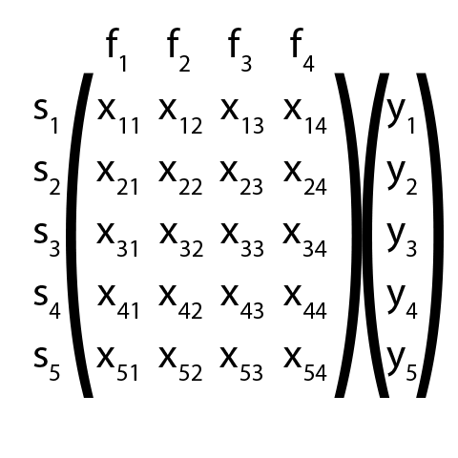
Filter methods
Evaluation function

Slide 12
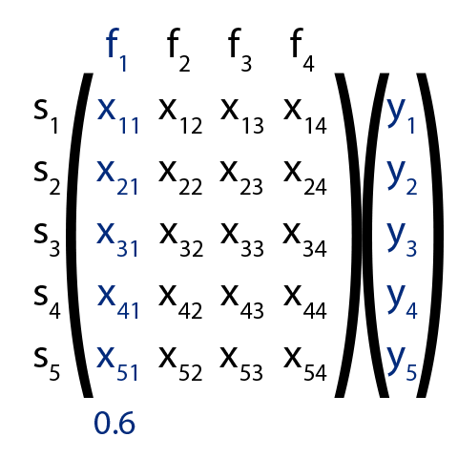
Filter methods
Evaluation function

Slide 13
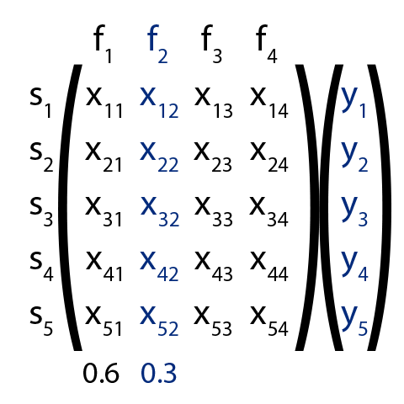
Filter methods
Evaluation function

Slide 14
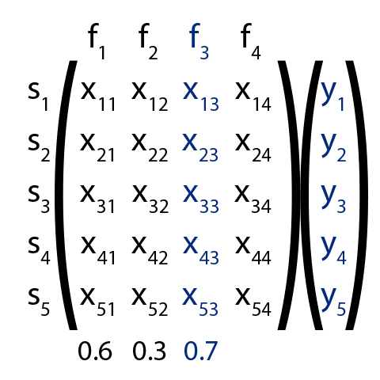
Filter methods
Evaluation function

Slide 15
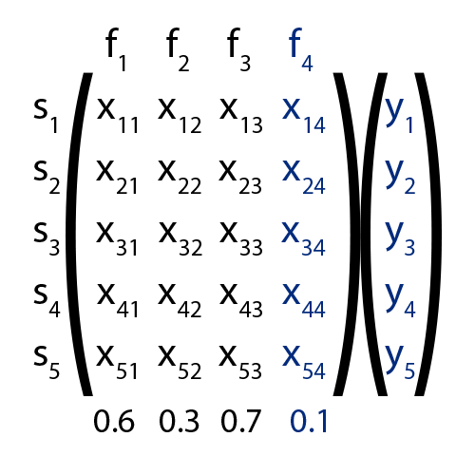
Filter methods
Evaluation function
T-test/ANOVA
Mutual Information
Correlation
Selection
Threshold

Slide 16
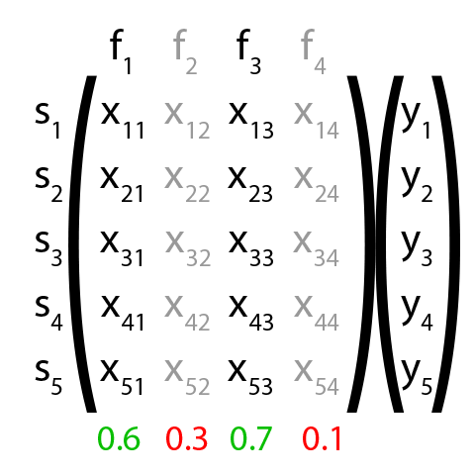
Filter methods
Evaluation function
T-test/ANOVA
Mutual Information
Selection
Threshold
Select k best

Slide 17
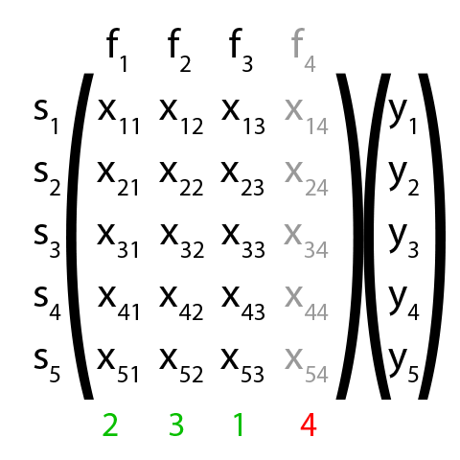
Filter methods
Evaluation function
T-test/ANOVA
Mutual Information
Selection
Threshold
Select k best
Fast and simple
Separate features
Notes:
10 minutes

Slide 18
Wrapper methods
Feature sets
Evaluation function
Set improvement
Threshold

Slide 19
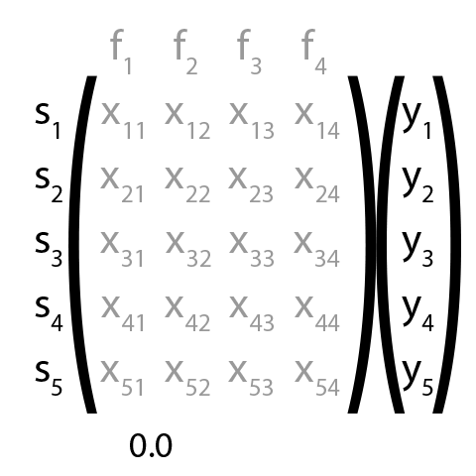
Wrapper methods
Feature sets
Evaluation function
Set improvement
Threshold

Slide 20
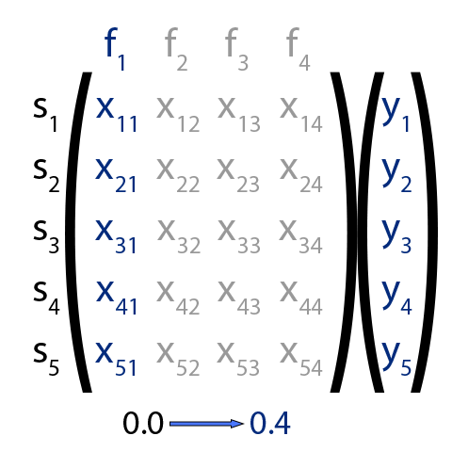
Wrapper methods
Feature sets
Evaluation function
Set improvement
Threshold

Slide 21
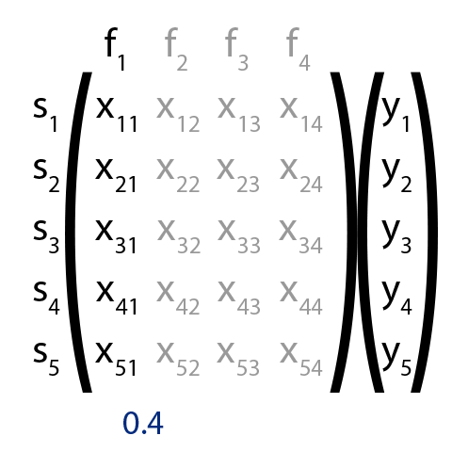
Wrapper methods
Feature sets
Evaluation function
Set improvement
Threshold

Slide 22
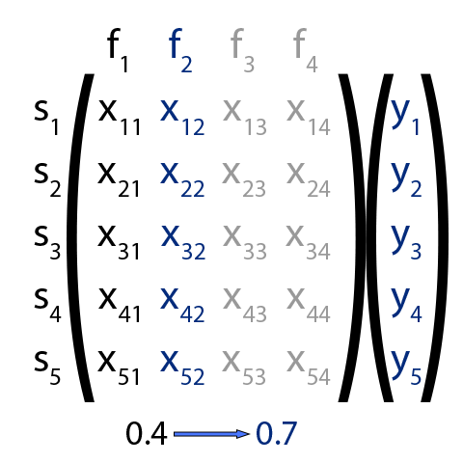
Wrapper methods
Feature sets
Evaluation function
Set improvement
Threshold

Slide 23
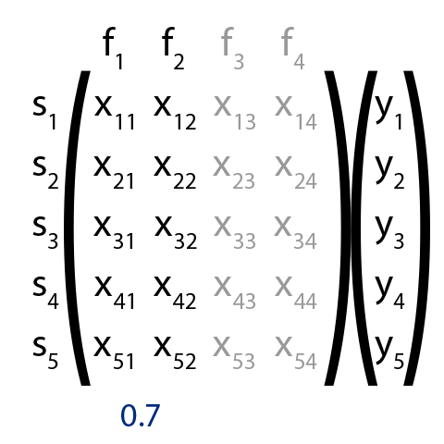
Wrapper methods
Feature sets
Evaluation function
Set improvement
Threshold

Slide 24
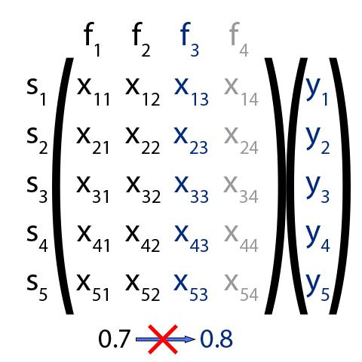
Wrapper methods
Feature sets
Evaluation function
Set improvement
Threshold

Slide 25
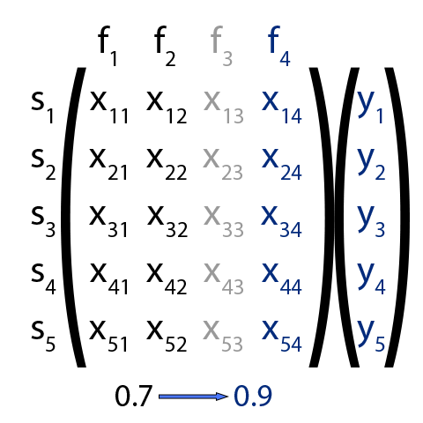
Wrapper methods
Feature sets
Evaluation function
Conditional dependency functions
Machine learning algorithms

Slide 26

Wrapper methods
Forward selection
Backward selection
Combinations
Pick-l-Take-Away-r (PTA)
Floating selection
Stochastic selection

Slide 27
Wrapper methods
Parameters
Feature order
Evaluation function
Threshold
Also feature dependencies
Longer computation time
Especially backward and stochastic

Slide 28
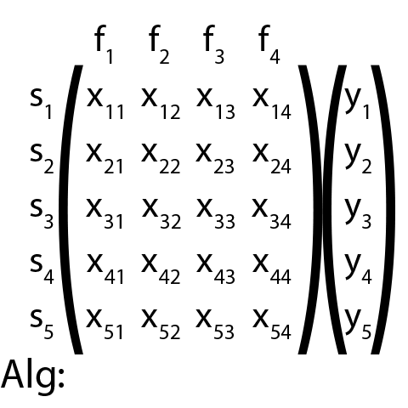
Embedded methods
Machine learning algorithms
Weights
Coefficients
Feature importance

Slide 29
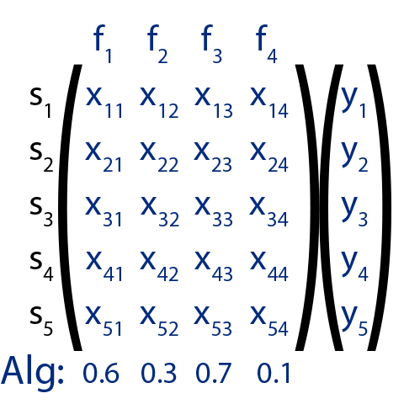
Embedded methods
Machine learning algorithms
Weights
Coefficients
Feature importance
Selection
Threshold

Slide 30
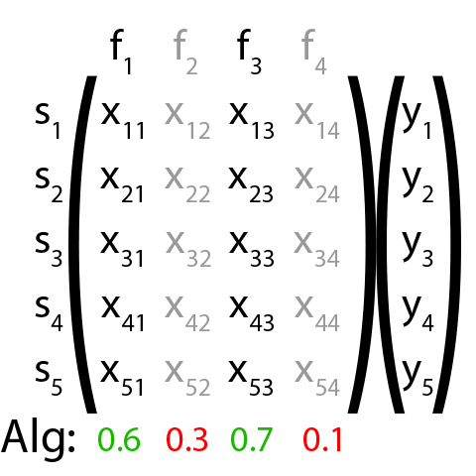
Embedded methods
Machine learning algorithms
Weights
Coefficients
Feature importance
Selection
Threshold
Select k best

Slide 31
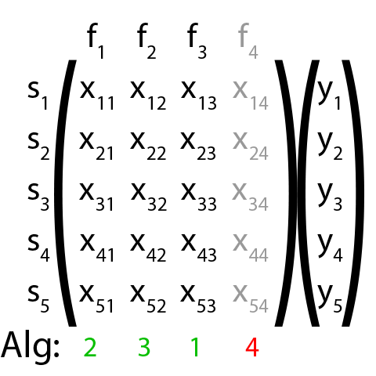
Embedded methods
Machine learning algorithms
Weights
Coefficients
Feature importance
Selection
Threshold
Select k best

Slide 32
Embedded methods
Similar to filter methods
Low computation time
Some feature dependencies
Notes:
16 min

Slide 33
Experiment 1
Filter methods
4 datasets
2 microarray (50.000+)
2 mass spectrometry (1.000-10.000)
Evaluation functions
T-test/ANOVA
Mutual Information
Feature selection
Minimum 1
Maximum 1000
Quality testing
Logistic regression accuracy ([0, 1])

Slide 34
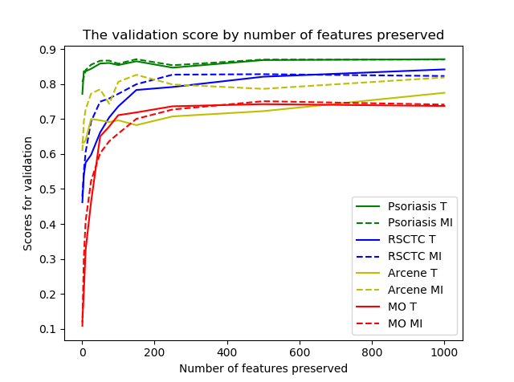
Experiment 1
Evaluation functions
Similarity T-test/ANOVA (T) and Mutual Information (MI)
Feature preservation
200 features limit

Slide 35
Experiment 2
Feature selection methods quality
4 datasets
2 microarray (50.000+)
2 mass spectrometry (1.000-10.000)
Feature selection methods
Filter methods
Wrapper methods
Embedded methods
Quality testing
Logistic regression accuracy ([0, 1])

Slide 36
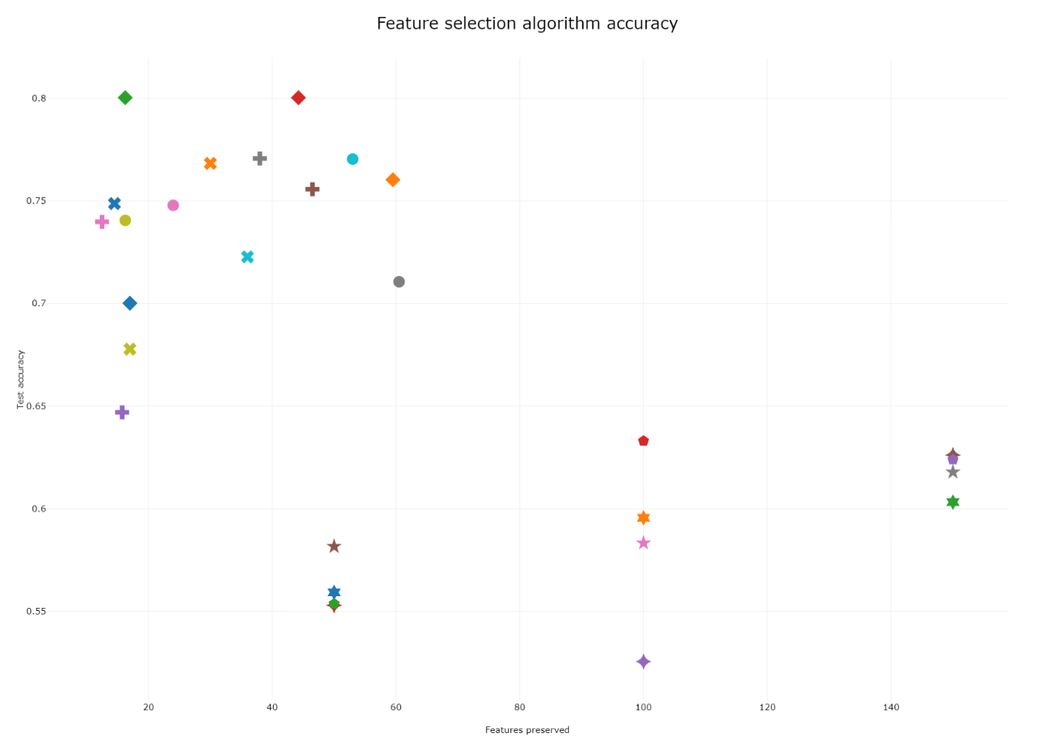
Experiment 2

Slide 37
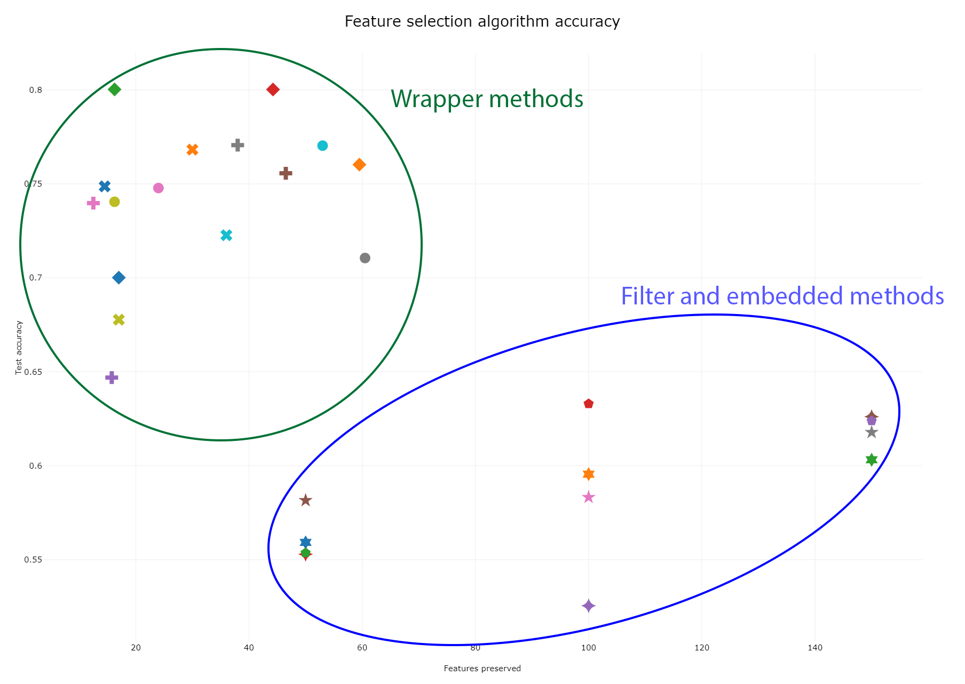
Experiment 2
Quality
Wrapper methods outperform
No computation time

Slide 38
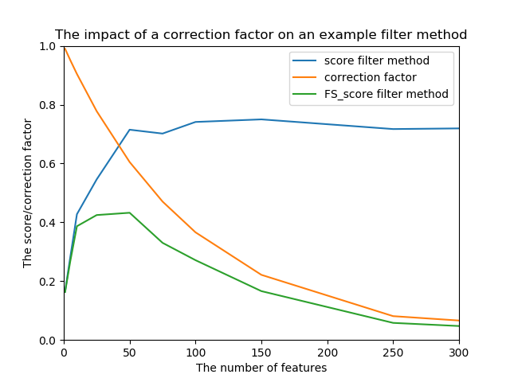
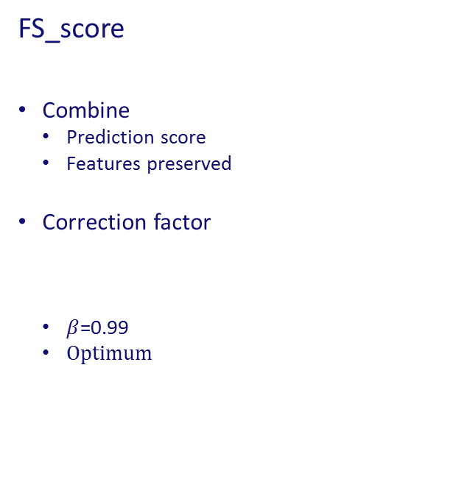
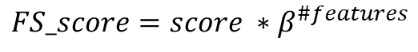
FS_score
Combine
Prediction score
Features preserved
Correction factor
$β$=0.99
Optimum
$$FS_score=score ∗β^{\#features}$$

Slide 39
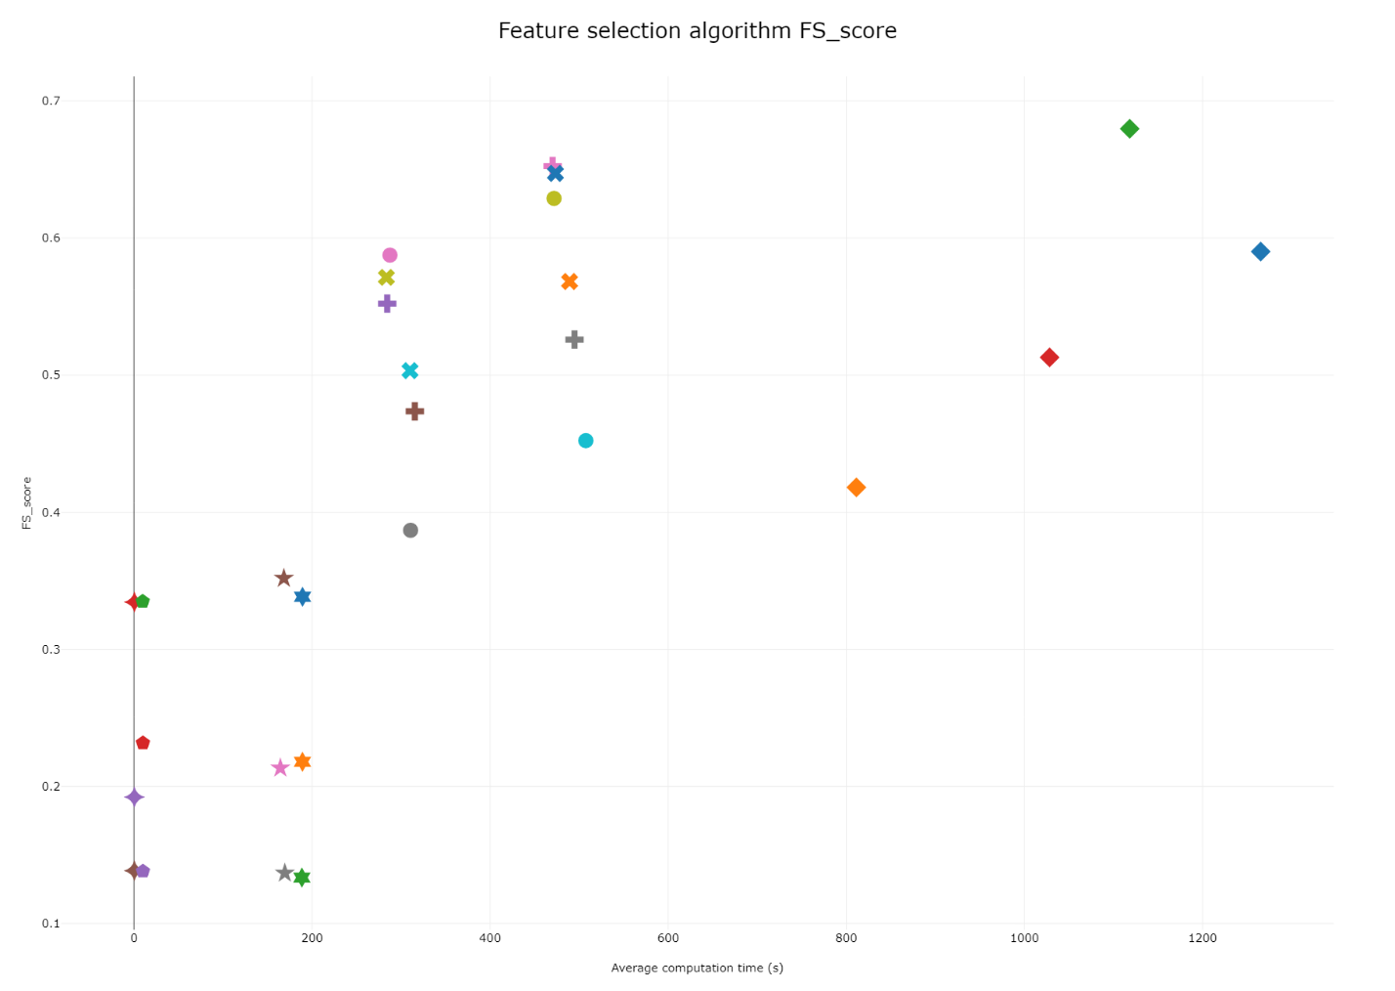
Experiment 2
Pareto-front

Slide 40
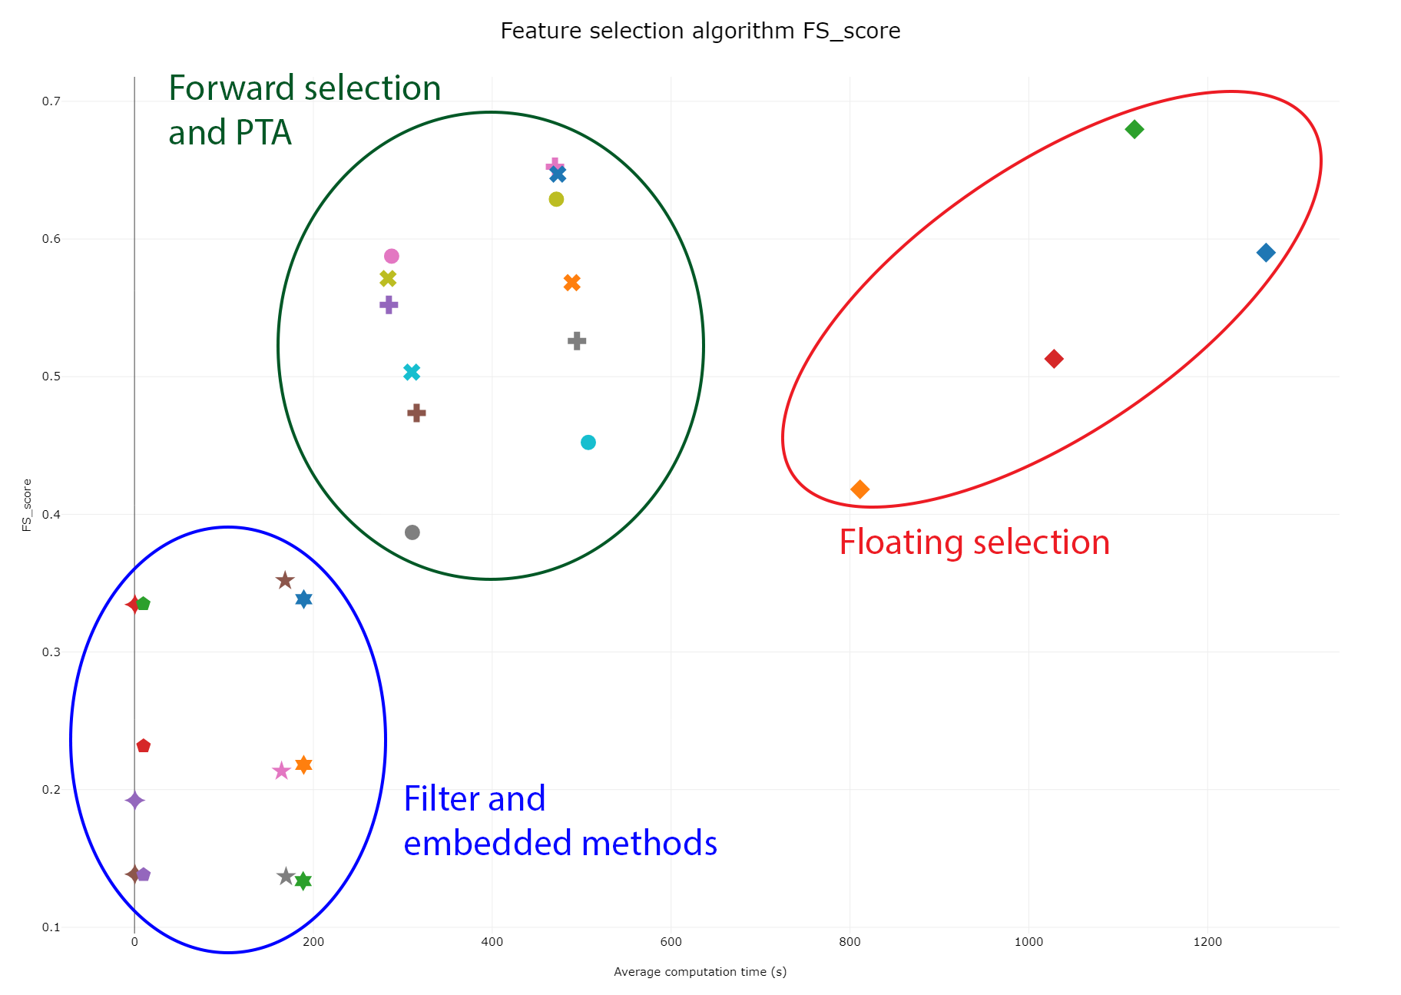
Experiment 2
Pareto-front
Differences
Wrapper methods

Slide 41
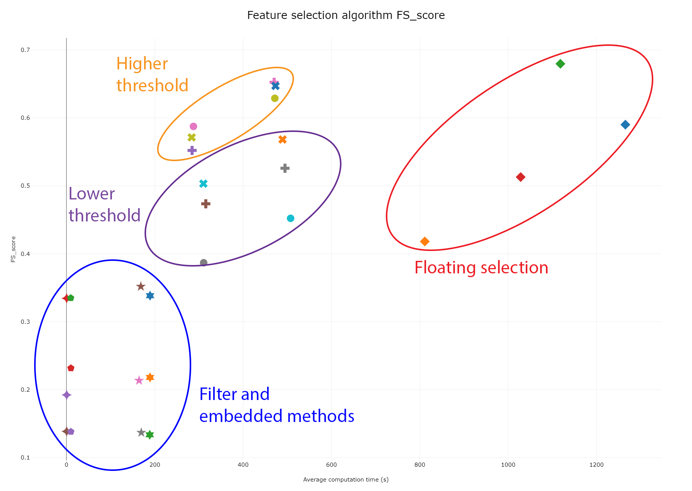
Experiment 2
Pareto-front
Differences
Wrapper methods
Threshold

Slide 42
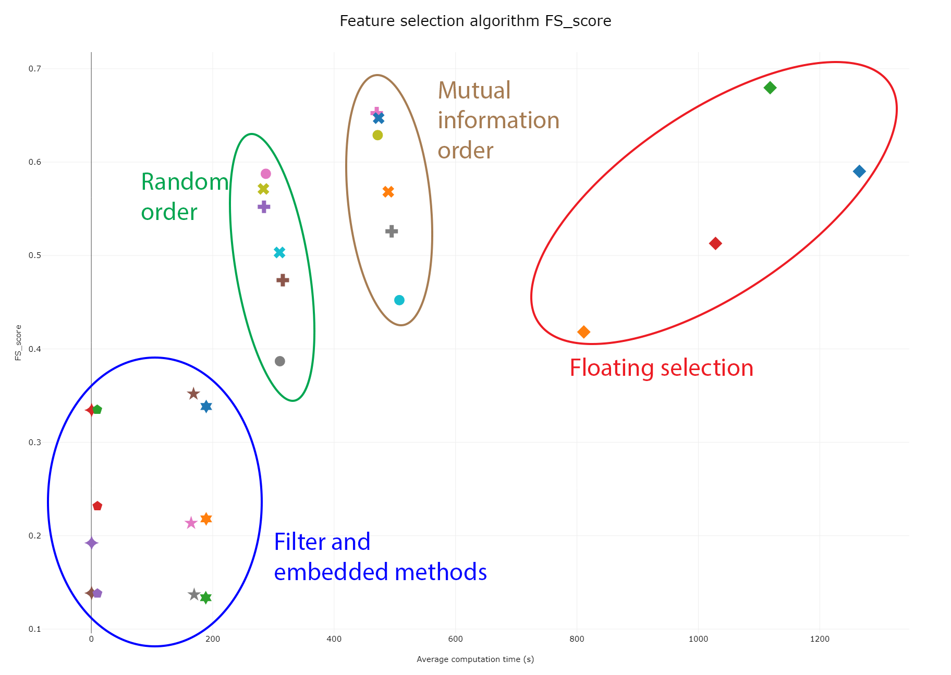
Experiment 2
Pareto-front
Differences
Wrapper methods
Threshold
Order

Slide 43
Experiment 3
Automated machine learning tool
Automated machine learning
Search for best analysis
Tree-based Pipeline Optimization Tool (TPOT)
Implements automated machine learning
Sub-optimal for feature selection
4 datasets
2 microarray (50.000+)
2 mass spectrometry (1.000-10.000)
3 Additions
FS_score
Bias towards feature selection
New set feature selection algorithms

Slide 44
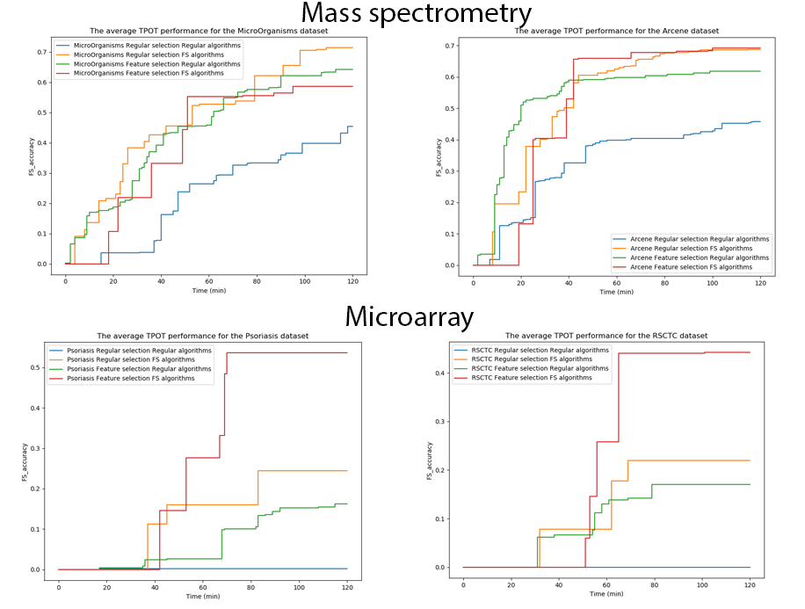
Experiment 3
Additions
None (Blue)
New algorithms (Orange)
Feature selection bias (Green)
Both (Red)
Improved
Microarray both best
Mass spectrometry debatable
Notes:
+- 25 minuten

Slide 45
Missing Value Handling
Datasets
Clinical
Survey
Missing value handling methods
List Deletion
Single imputation
Multiple imputation

Slide 46
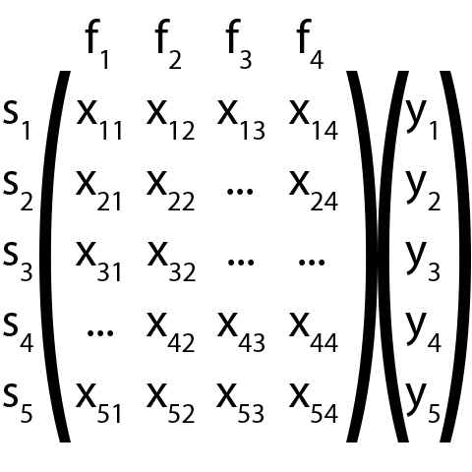
Missing values

Slide 47
List deletion

Slide 48

List deletion
Available Case Analysis (ACA)

Slide 49

List deletion
Available Case Analysis (ACA)
Complete Case Analysis (CCA)
Weighted Case Analysis (WCA)

Slide 50
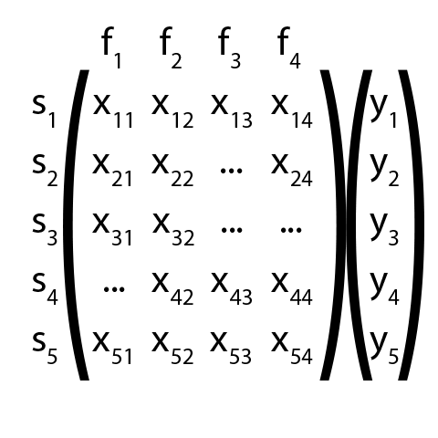
Single imputation
Mean imputation

Slide 51
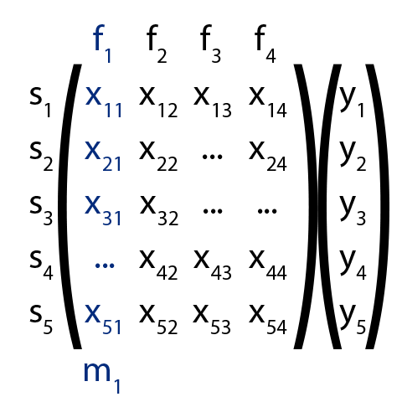
Single imputation
Mean imputation

Slide 52
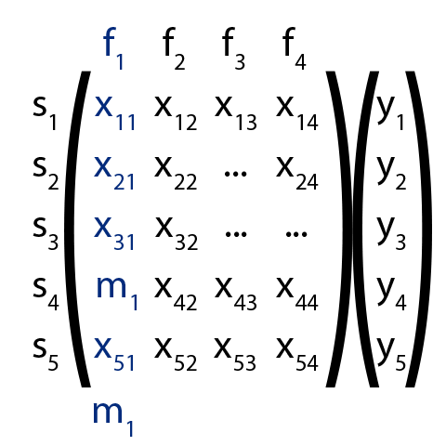
Single imputation
Mean imputation

Slide 53
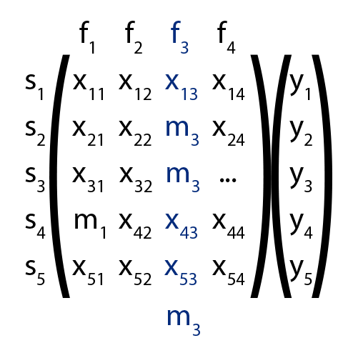
Single imputation
Mean imputation

Slide 54
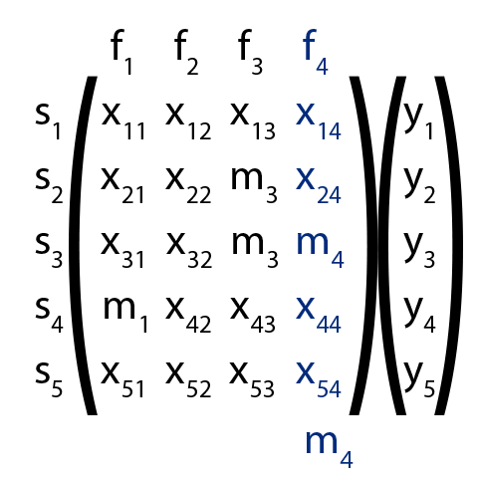
Single imputation
Mean imputation
Median
Mode
Hot deck imputation

Slide 55
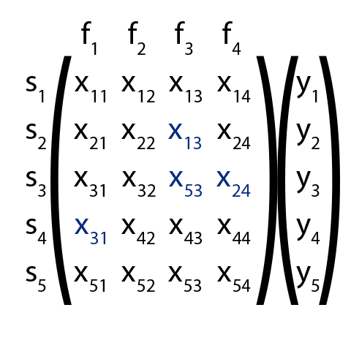
Single imputation
Mean imputation
Hot deck imputation

Slide 56
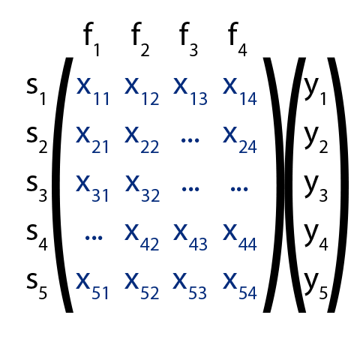
Single imputation
Advanced imputation
Regression imputation
Nearest neighbour imputation (kNN)

Slide 57
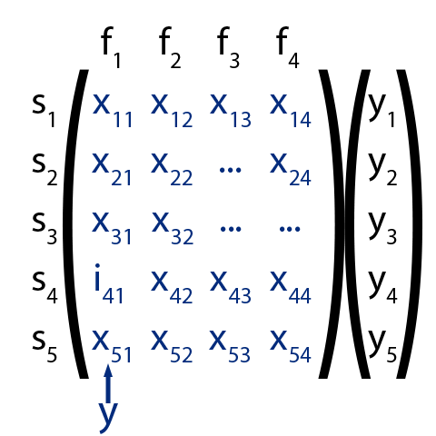
Single imputation
Advanced imputation
Regression imputation
Nearest neighbour imputation (kNN)

Slide 58
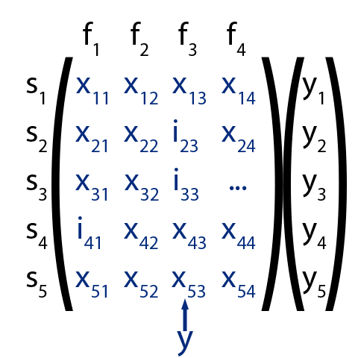
Single imputation
Advanced imputation
Regression imputation
Nearest neighbour imputation (kNN)

Slide 59
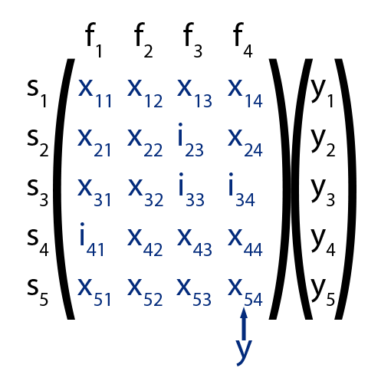
Single imputation
Advanced imputation
Regression imputation
K Nearest neighbour imputation (kNN)

Slide 60
Single imputation
Missing indicator

Slide 61
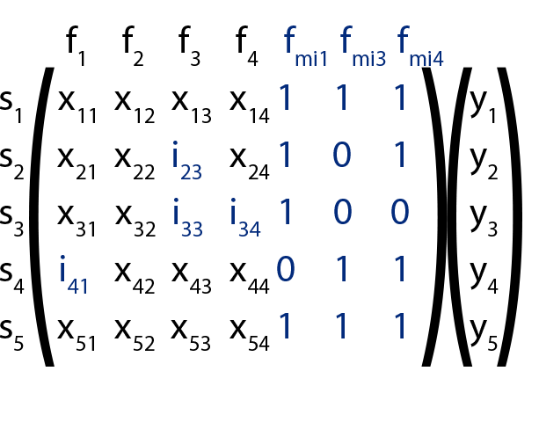
Single imputation
Missing indicator

Slide 62
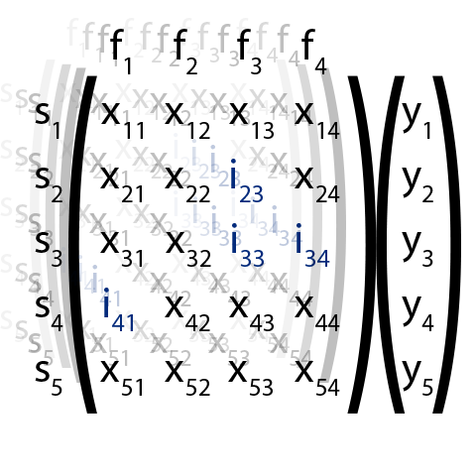
Multiple Imputation
Multiple datasets
Multiple Imputation Chained Equations (MICE)
Notes:
+- 29

Slide 63
Experiment 1
Feature distributions
4 datasets
3 clinical
1 survey
Feature distributions
Mean
Standard deviation
T-test similarity
Missing value handling
List deletion: CCA, WCA
Single imputation: Mean, Hot deck, Regression, kNN
Multiple imputation: MICE (one dataset)

Slide 64

Experiment 1
Percentages
> 40% very difficult
> 15% some difficulty
Remove >15%

Slide 65

Experiment 1
List deletion
Mean and hot deck
Regression and kNN
MICE
Notes:
+- 32

Slide 66
Experiment 2
Missing value handling quality
3 datasets
2 clinical
1 survey
Quality output
Logistic regression F1-score
Missing value handling
List deletion: CCA, ACA, WCA
Single imputation: Mean, Hot deck, Regression, kNN, Missing Indicator
Multiple imputation: MICE
>15% missing values removed

Slide 67

Experiment 2

Slide 68

Experiment 2
List Deletion

Slide 69

Experiment 2
List Deletion
Mean Imputation

Slide 70

Experiment 2
List Deletion
Mean Imputation
Regression, kNN and MICE
Notes:
+- 33

Slide 71
Dataset exploration
Datasets
Clinical
Mass spectrometry
Exploration
Dataset issues
Meta-features
Package metalearn

Slide 72
Dataset issues
Many features
Missing values

Slide 73

Dataset issues
Many features
Missing values
Feature types

Slide 74

Dataset issues
Many features
Missing values
Feature types
Output imbalance

Slide 75

Dataset issues
Many features
Missing values
Feature types
Output imbalance
Feature irrelevance

Slide 76

Dataset issues
Many features
Missing values
Feature types
Output imbalance
Feature irrelevance
Multicollinearity

Slide 77

Dataset issues
Many features
Missing values
Feature types
Output imbalance
Feature irrelevance
Multicollinearity
Feature imbalance

Slide 78
Issue recognition
Meta-features
Dataset characteristics
Dataset size, missing value ratio, …
Link with dataset issues
Package metalearn

Slide 79
Analysis 1
Dataset exploration with metalearn
2 datasets
1 mass spectrometry
1 clinical
Issues <> meta-features
Result
Issues recognizable
Multicollinearity
Feature irrelevance
Needs clarification

Slide 80
Analysis 2
Dataset exploration with metalearn
2 datasets
1 mass spectrometry
1 clinical
metalearn
Added meta-features
Outlier detection
Plots
Results
All issues explained
Better understanding
Notes:
+- 38

Slide 81
Framework cBioF
Phases
Datasets
Exploration
Preprocessing
Analysis

Slide 82
Phase 1 – Dataset specifics
Focus on dataset issues
Microarray
Mass spectrometry
Clinical
Survey

Slide 83
Phase 2 – Dataset exploration
Exploration of potential issues
Many features
Missing values
Feature types
Output imbalance
Feature irrelevance
Multicollinearity
Feature imbalance

Slide 84
Phase 3 – Preprocessing
Preprocessing the found issues
Many features
Missing values
Feature types
Output imbalance
Feature irrelevance
Multicollinearity
Feature imbalance
Feature selection
Missing value handling
One-hot encoding
Normalisation/Standardisation
Score usage

Slide 85
Phase 4 – Analysis
Automated machine learning
TPOT
Feature selection extension

Slide 86

cBioF: GUI
Automated machine learning
TPOT
Feature selection extension
Notes:
+- 41

